Slide 1
Leveling Up your Teams
Advanced Mob Programming Techniques

Slide 2
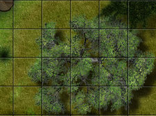
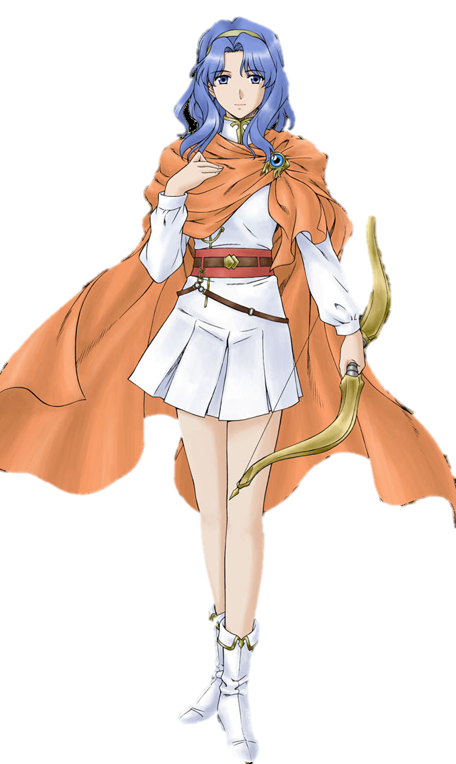
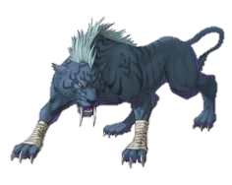
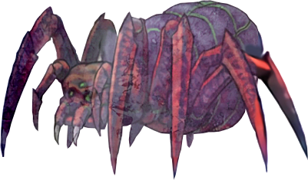
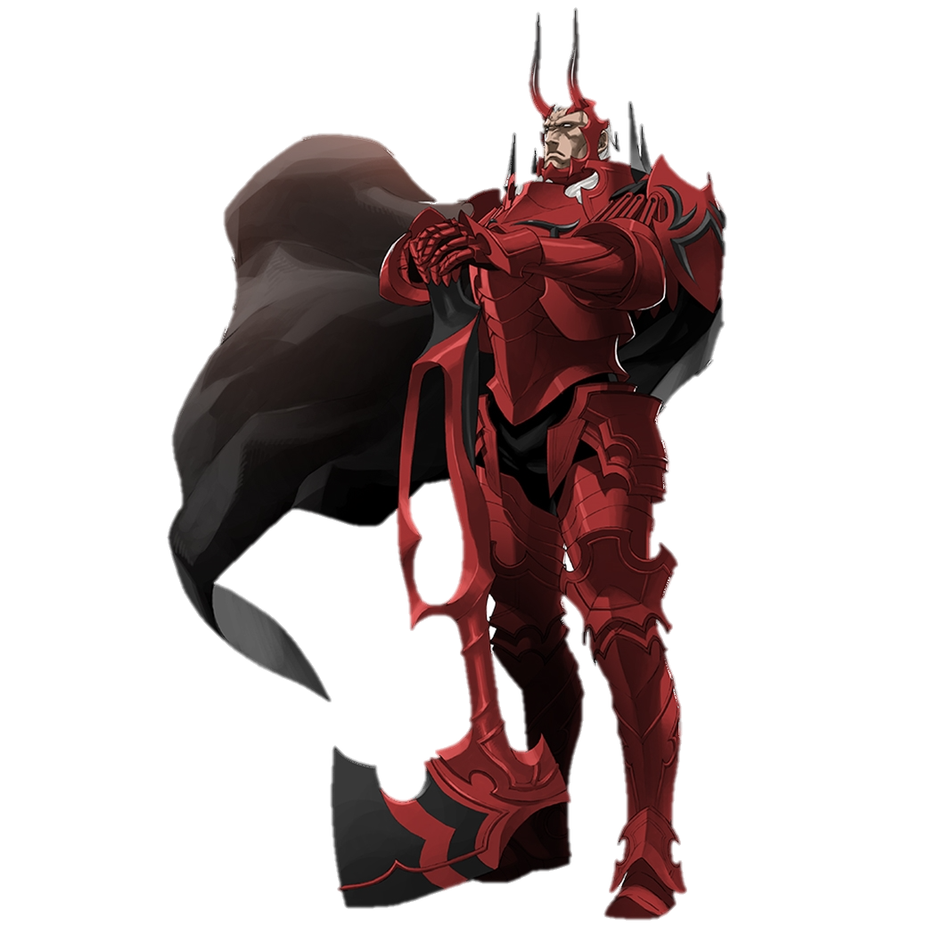
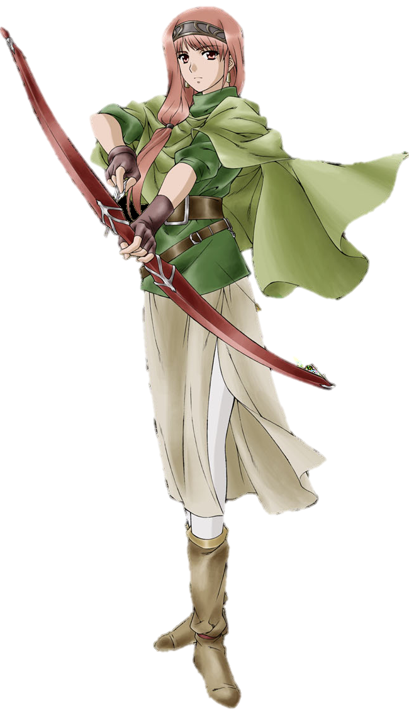
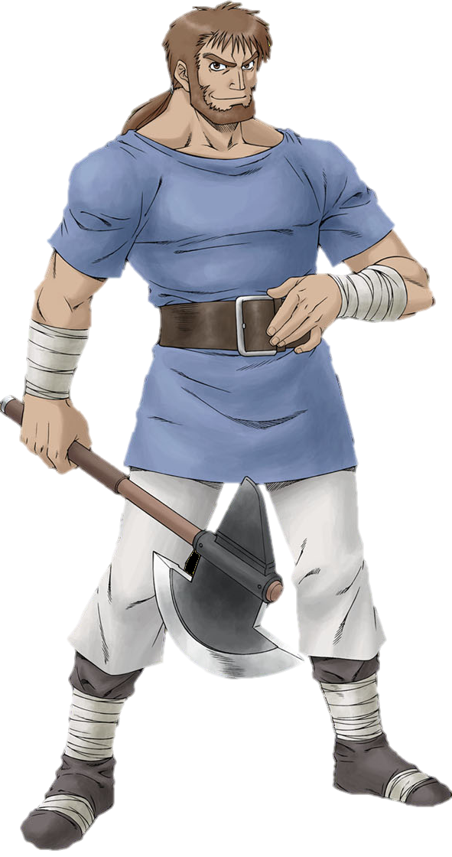
10
20
35
20
30
55
30
100
20
450
60
120
30
800
20
30

Slide 3
10
20
30
100
60
120

Slide 4
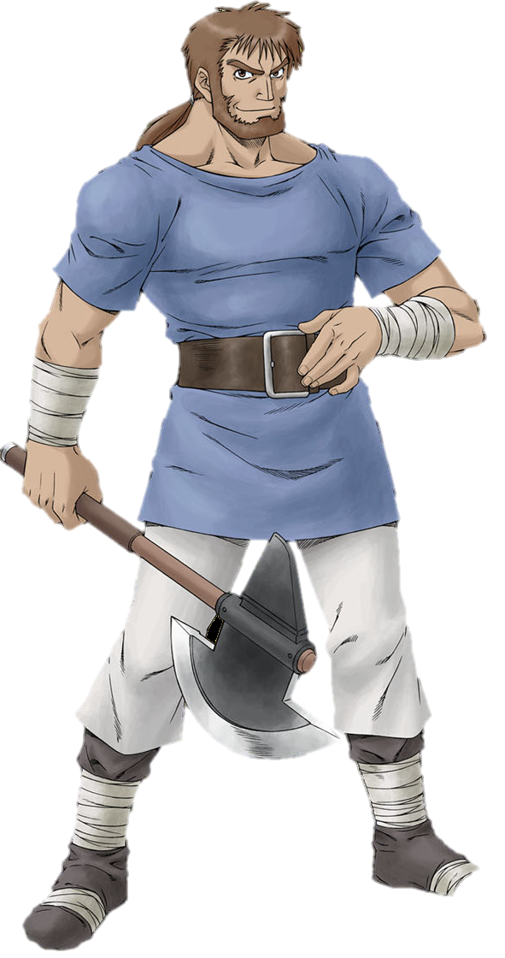
100
10
20
120
30
100
60
120
Balto

Slide 5
30
10
20
60
30
100
60
120
Naomi

Slide 6
10
10
20
20
30
100
60
120
Faye

Slide 7
10
20
35
20
30
55
30
100
20
60
120
30
20
30

Slide 8
100
20
120
30
Balto
Vamspider

Slide 9
100
20
120
30
Balto
Vamspider

Slide 10
450
800
Red Blade

Slide 11
10
20
30
100
450
60
120
800

Slide 12
100
20
120
30
Balto
Vamspider

Slide 13
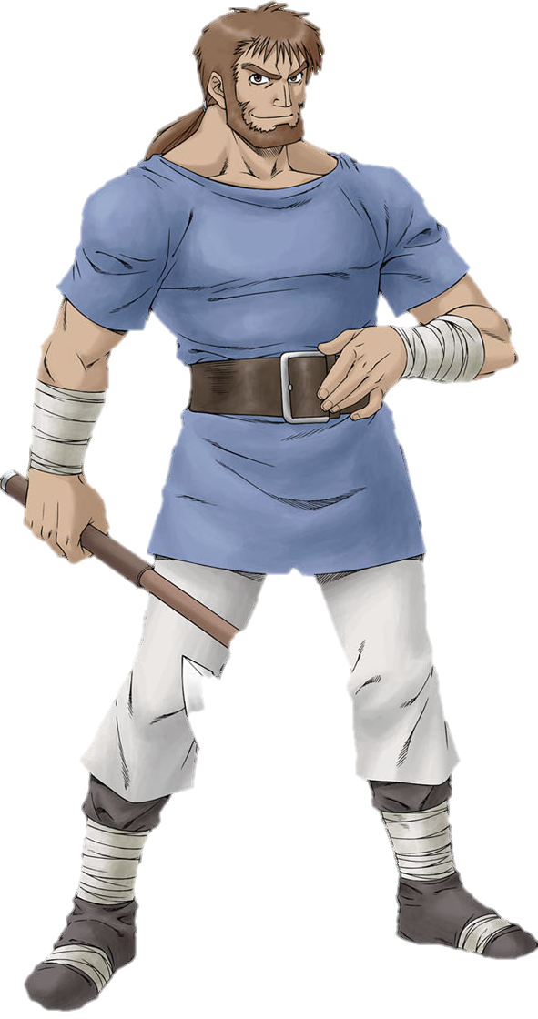
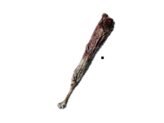
10
20
120
30
Balto
Vamspider

Slide 14
10
20
20
30
Vamspider
Faye

Slide 15
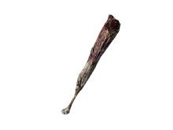
10
20
35
20
30
55
30
10
20
60
120
30
20
30

Slide 16
Why include Balto?
10
20
35
20
30
55
30
10
20
60
120
30
20
30

Slide 17



Slide 18
Oh, I know this…

Slide 19
…um…

Slide 20
Hold on, I think
he can get this….
…um…

Slide 21
Let’s start by…

Slide 22
That’s not right, but
be patient maybe he’ll
get there in the end
…........…

Slide 23
done.

Slide 24
Oh, I don’t think he’s
seen this technique before,
time for me to
introduce it.
done.

